Slide 1
Department of Technical Education Govt. CPC POLYTECHNIC Mysore Presentation On : Online Mentor Management
Under the guidance of :
Yeshaswini M R BE
Lecturer Of
Department of computer Science and Engg
By : Aishwarya Duth G[108CS15001]
Shaistha Khanum[108CS15047]
Farah Khanum [108CS15009]
SharadaKumar Shivanand Chandapur [108CS15049]

Slide 2
Abstract
The Education become an important part of society. As education is being developed in society, the educational management system has to be developed.
Online Mentor Management System consists of task such as student database, lecturers database, maintaining attendance and there performance.

Slide 3
Contents
Introduction
Online Mentor Management System
HOD Module
Working of Hod Module
Mentor Module
Working of Mentor Module
Student Module
Working of Student Module
Advantages & Disadvantages
Data flow diagram
Snapshots & Requirements
Conclusion
Bibliography

Slide 4
Introduction
Using Online mentor management system we can manage the student performance details throughout the academic year. The OBE based system provides the easiest way to manage the details of the student by the particularly assigned mentor and head of department (HOD).

Slide 5
Online Mentor Management
Online mentor management system helps to maintain the credential information and to improve overall students development.
Hod
Mentor/guide
Student

Slide 6
HOD Module
SUB MODULES:
Students
Add mentor
View mentor
Assign Students
View IA
View Attendance/Co-curricular
View CGPA and
Log out

Slide 7
Working of HOD module
Firstly the hod has to add mentor of the particular department and then they have to assign student to a particular mentor.
Then hod can view mentors, registered student, view IA marks, view attendance/co-curricular activities, view CGPA.
The whole project is managed under HOD control.

Slide 8
Mentor Module
Sub Modules:
Profile
View student
Subject
Add Attendance
View Attendance
Add IA
View IA
Add marks
View marks
Feedback
Send SMS
Logout

Slide 9
Working of Mentor Module
The mentor can add the marks of the students, attendance and other activities of their assigned students.
Mentor can view the overall performance of the students.
Sending SMS to the students parents whose attendance is shortage.
Receiving feedback from hod, helps mentor to know there progress towards their assigned students.

Slide 10
Student Module
The Sub Modules:
Profile
Add Personal Information
View Attendance/Co-curricular
View Marks
Log out

Slide 11
Working of Student
The Student first has to register to the web page.
After getting registered , the student gets his username and password so that he can get login to his account.
The student has to add their personal details.
The student can view their marks, attendance and co-curricular activities etc.

Slide 12
Advantages
To reduce paperwork.
To make storage information more efficient and secure.
To have a user friendly interface.
To operate it easily and with minimum experience.
To save time and energy of the admin.
Easy to back up the data.

Slide 13
Disadvantages
Maintaining and Updating the records into database is quite difficult.
Searching information of students is a difficult.

Slide 14
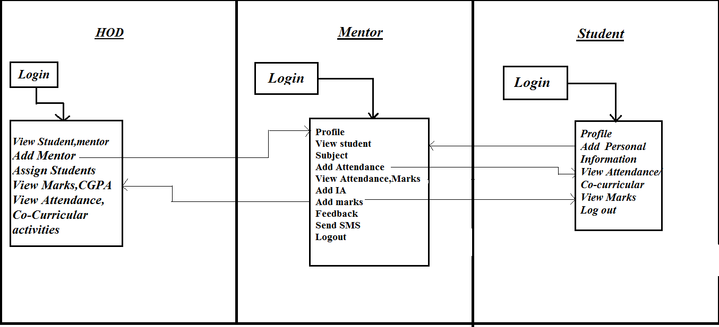
Data Flow Diagram

Slide 15
Requirements
Hardware Requirements
Processor - Pentium III and above
Speed - 1.1 Ghz min
Hard Disk - 20 GB
Software Requirements
Operating System - Windows
Programming Language - PHP, HTML, CSS, BOOTSTRAP
Storage - My sql

Slide 16

Snap Shots
Snapshot 1: Index page

Slide 17
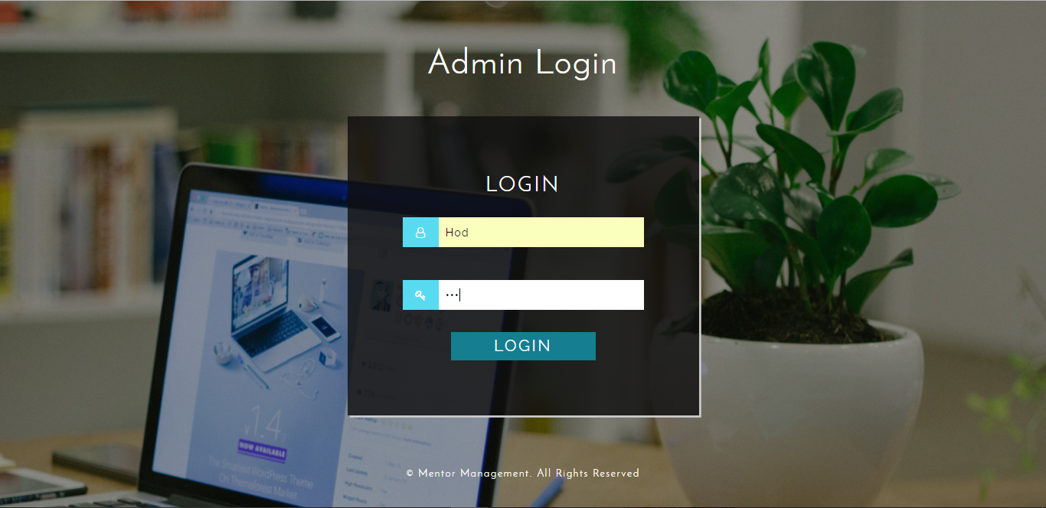
Snapshot 2: Admin Login page

Slide 18

Snapshot 3: Admin Dashboard page

Slide 19
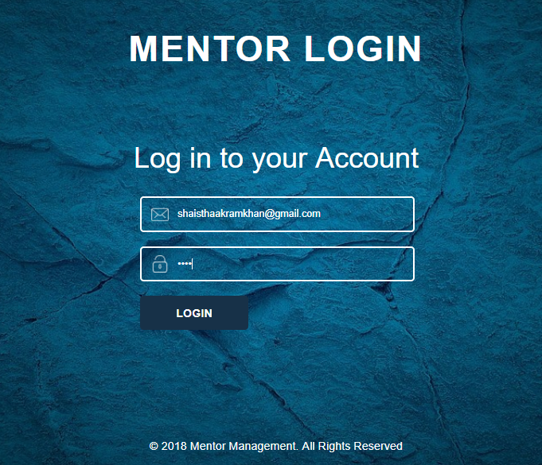
Snapshot 4: Mentor Login page

Slide 20

Snapshot 5: Mentor Dashboard page

Slide 21
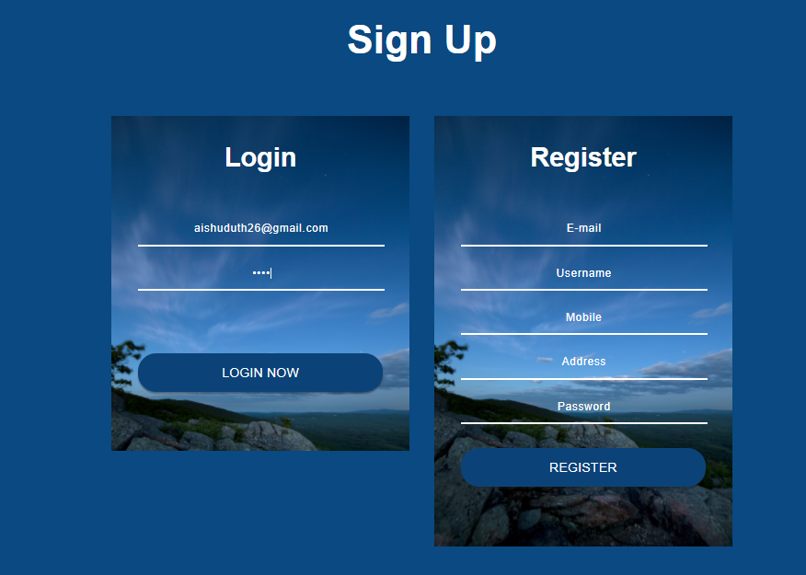
Snapshot 6: Student Login page

Slide 22

Snapshot 7: Student Dashboard page

Slide 23
CONCLUSION
This processes of project helps for all the students, Lecturers and Head of the department.
It provides accurate information always.
All gathered and extra information can be saved and can be accessed at any time.
It helps for students to get knowledge development.

Slide 24
BIBLOGRAPHY
www.rapidsofttechnologies.com
www. mybringback.com
www.tutorial-series/android-tutorial using-remote-databases-php-and-MySQL/
www.w3schools.com

